Slide 1
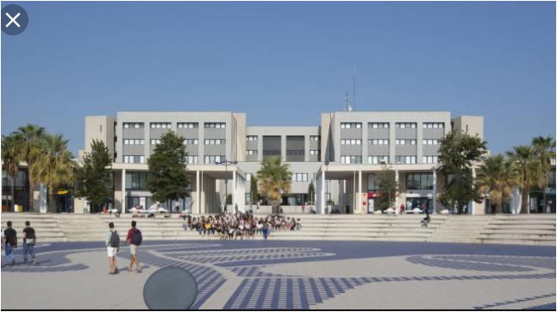
Voor aanzicht

Slide 2
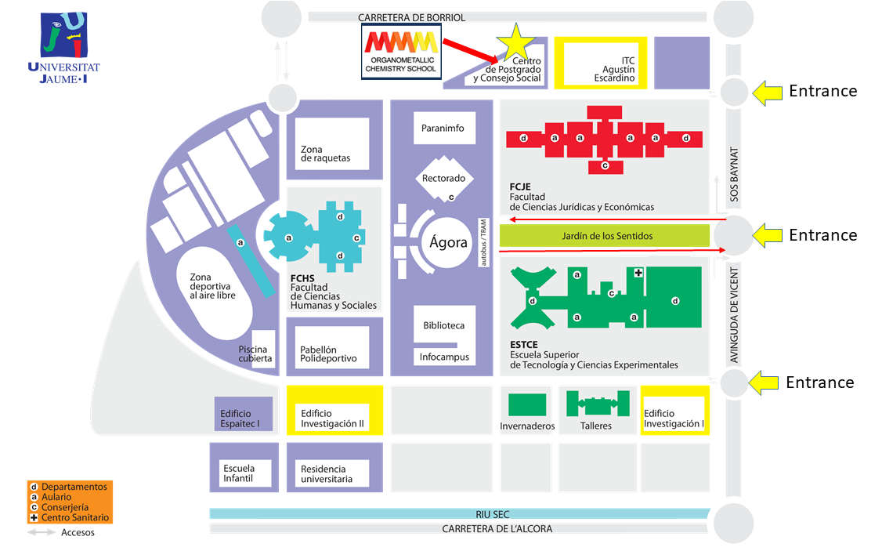
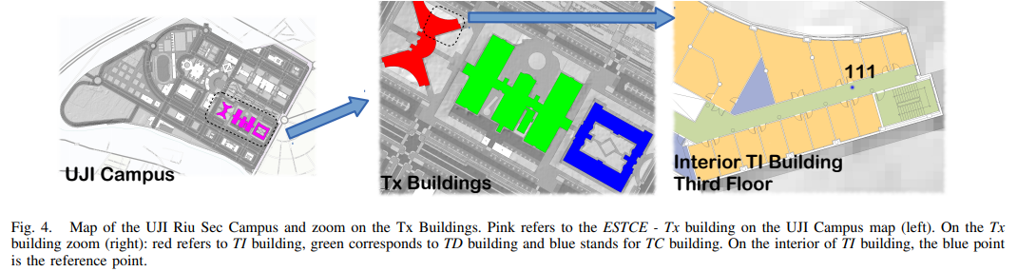

Slide 3
Goal
Test the accuracy (kappa.. of localization algorithms on RSSI levels or for
Performing a comparison of localization algorithms under the same experimental framework
Or f.e.
How the internal structure of the building is related with the WLAN access points and, therefore, how the number and position of these points can be optimised without being out of WIFI range. Why? for hardware reduction and installation efforts or to reduce the redundant access points keeping a complete coverage.
Detection of low coverage places to optimize data and internet coverage

Slide 4
Data summary
The data covers three buildings with 4 or more floors and almost 110.000m2. It can be used for classification, e.g. actual building and floor identification, or regression, e.g. actual longitude and latitude estimation. It was created in 2013 by means of more than 20 different users and 25 Android devices. The database consists of 19937 training/reference records (trainingData.csv file) and 1111 validation/test records (validationData.csv file). The 529 attributes contain the WiFi fingerprint, the coordinates where it was taken, and other useful information. Each WiFi fingerprint can be characterized by the detected Wireless Access Points (WAPs) and the corresponding Received Signal Strength Intensity (RSSI). The intensity values are represented as negative integer values ranging -104dBm (extremely poor signal) to 0dbM. The positive value 100 is used to denote when a WAP was not detected. During the database creation, 520 different WAPs were detected. Thus, the WiFi fingerprint is composed by 520 intensity values. Then the coordinates (latitude, longitude, floor) and Building ID are provided as the attributes to be predicted. Additional information has been provided. The particular space (offices, labs, etc.) and the relative position (inside/outside the space) where the capture was taken have been recorded. Outside means that the capture was taken in front of the door of the space. Information about who (user), how (android device & version) and when (timestamp) WiFi capture was taken is also recorded.

Slide 5
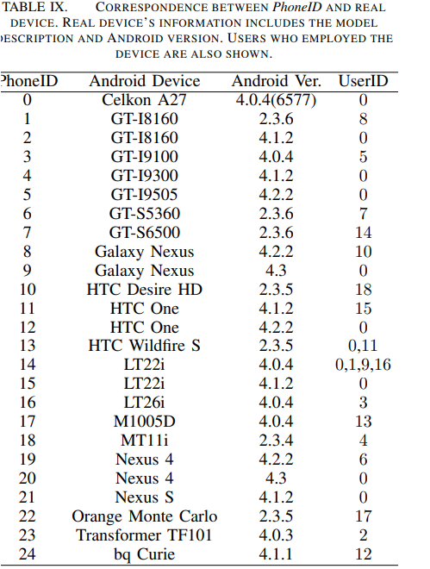
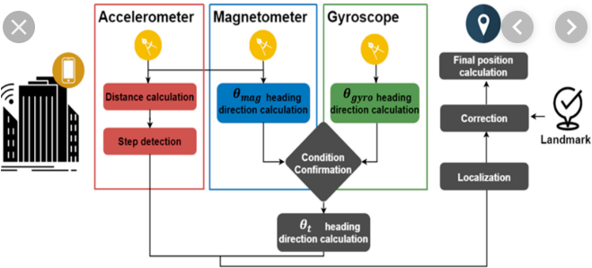
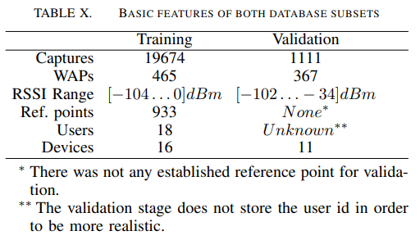
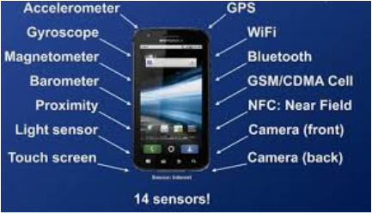
Data collected by 18 users & 20 (25) Android devices

Slide 6
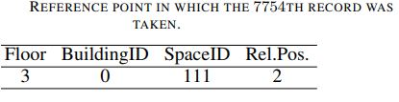
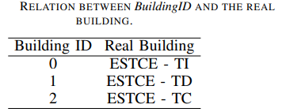

21049 records = single record with 529 numeric elements
18 users, 20 (25 –Android) devices
19.937 training records
1.111 test records (525 & 526 & 527 empty with default value 0 in both fields and to simulate real localization system)
529 attributes, integer/real
933 reference points (places)
Infrastructure less approach by WAP’s
WLAN access points
-45dBm to 0dBm is insignificant and cover only 1.7% of total RSSI levels
-95dBm is also insignificant (2.3% of total RSSI measures)
Building 0 | Building 1 | Building 2
Floor 1, space id 111, Rel. Pos. 2 | Floor 1 space id 111, Rel. Pos. 2 | Floor 2.1 space id 111, Rel. Pos. 2
Floor 2… | Floor 2… | Floor 2…
Floor 3… | Floor 3… | Floor 3…
Floor 4… | Floor 4… | Floor 4…
Regression
Predicting attributes for estimating position of user
Fingerprint
Space id like office, corridor, classroom
WAP 001-519 (RSSI levels) | WAP520 (RSSI - intensity values | 521 (Neg. real- Longitude | 522 (Pos. real- Latitude | 523 (Integer value Altitude Floor 0-4) | 524 (cat. Integer) Building id | 525 space Id (cat. integer) | 526 Relative position for the space (cat. Integer) | 527 User id. Cat. Integer | 528 Phone ID. Android ID Cat. integer | 529 Time stamp Integer value
-104. – 0 (= poor – extremely good) | -104. – 0 (= poor – extremely good) | -7695.9387549299299000 | 4864745.7450159714 | Altitude in floors Inside the building | 0 - 2 | Office, Corridor, Classroom | 1 – inside space, 2 – outside space in front of the door of the space (corridor) | 0 USER0000 (Validation user – N/A) ID USER HEIGHT 1 USER0001 170 2 USER0002 176 3 USER0003 172 4 USER0004 174 5 USER0005 184 6 USER0006 180 7 USER0007 160 8 USER0008 176 9 USER0009 177 10 USER0010 186 11 USER0011 176 12 USER0012 158 13 USER0013 174 14 USER0014 173 15 USER0015 174 16 USER0016 171 17 USER0017 166 18 USER0018 162 | 0 Celkon A27 4.0.4(6577) 0 1 GT-I8160 2.3.6 8 2 GT-I8160 4.1.2 0 3 GT-I9100 4.0.4 5 4 GT-I9300 4.1.2 0 5 GT-I9505 4.2.2 0 6 GT-S5360 2.3.6 7 7 GT-S6500 2.3.6 14 8 Galaxy Nexus 4.2.2 10 9 Galaxy Nexus 4.3 0 10 HTC Desire HD 2.3.5 18 11 HTC One 4.1.2 15 12 HTC One 4.2.2 0 13 HTC Wildfire S 2.3.5 0,11 14 LT22i 4.0.4 0,1,9,16 15 LT22i 4.1.2 0 16 LT26i 4.0.4 3 17 M1005D 4.0.4 13 18 MT11i 2.3.4 4 19 Nexus 4 4.2.2 6 20 Nexus 4 4.3 0 21 Nexus S 4.1.2 0 22 Orange Monte Carlo 2.3.5 17 23 Transformer TF101 4.0.3 2 24 bq Curie 4.1.1 12 | 12:02:22 PM GMT +02
+100 (not detected) | +100 (not detected) | to | to | 0 - 4
+100 = artificial value | +100 = artificial value | -7299.786516730871000 | 4865017.3646842018 |  |  |  |  |  |  | UNIX Time
Real world coordinates

Slide 7
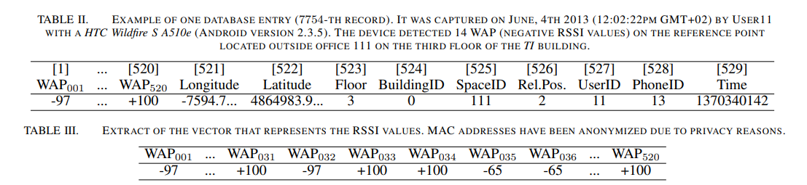
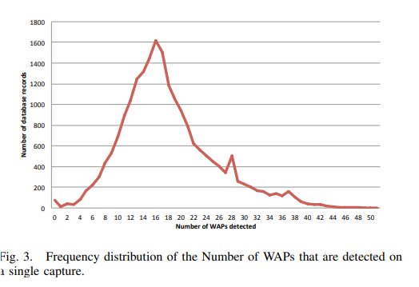
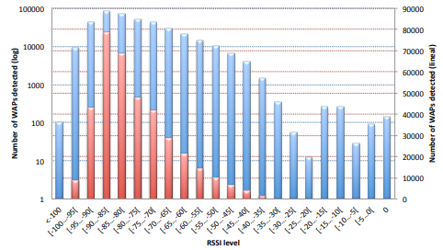
Example of 7754 th record (table II)
1
2
3
4
5
6
7
8
9
10
11
12
13
14
In average 8-25 WAP’s are detected on a single capture
and differs depending on environment and on device

Slide 8
Summary (Workfile[,521:529])
LONGITUDE LATITUDE FLOOR BUILDINGID SPACEID RELATIVEPOSITION USERID
Min. :-7691 Min. :4864746 Min. :0.000 Min. :0.000 Length:19937 Min. :1.000 Min. : 1.000
1st Qu.:-7595 st Qu.:4864821 1st Qu.:1.000 1st Qu.:0.000 Class :character 1st Qu.:2.000 1st Qu.: 5.000
Median :-7423 Median :4864852 Median :2.000 Median :1.000 Mode :character Median :2.000 Median :11.000
Mean :-7464 Mean :4864871 Mean :1.675 Mean :1.213 Mean :1.833 Mean : 9.068
3rd Qu.:-7359 3rd Qu.:4864930 3rd Qu.:3.000 3rd Qu.:2.000 3rd Qu.:2.000 3rd Qu.:13.000
Max. :-7301 Max. :4865017 Max. :4.000 Max. :2.000 Max. :2.000 Max. :18.000
PHONEID
Min. : 1.00
1st Qu.: 8.00
Median :13.00
Mean :13.02
3rd Qu.:14.00
Max. :24.00
TIMESTAMP
Min: "2013-05-30 10:15:24"
1st Qu: "2013-06-12 16:50:18"
Median "2013-06-20 08:12:52"
Mean: "2013-06-16 22:20:50"
3rd Qu: "2013-06-20 09:37:26"
Max: "2013-06-20 14:15:45"

Slide 9
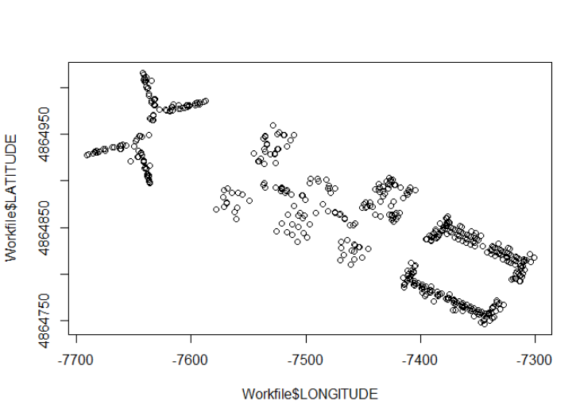
Plot longitude / latitude - Training

Slide 10
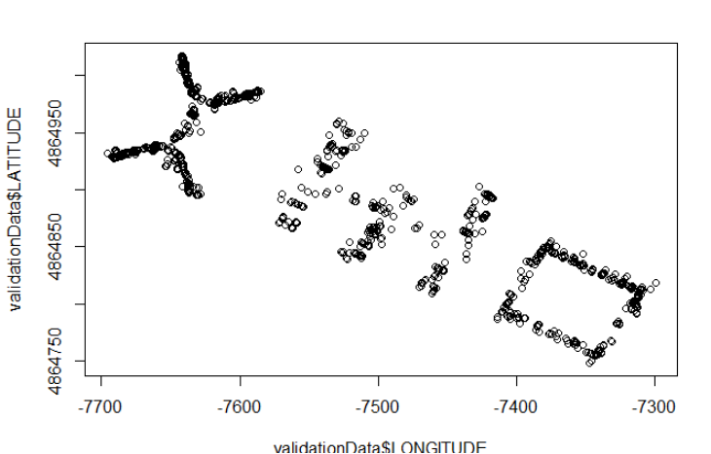
Plot long / lat – Training vs Validation

Slide 11
^{test} KNN in EDA fase
Fit_long
k-Nearest Neighbors
1502 samples
529 predictor
Pre-processing: median imputation (525), remove (122)
Resampling: Cross-Validated (10 fold, repeated 1 times)
Summary of sample sizes: 1352, 1353, 1352, 1351, 1351, 1352, ...
Resampling results across tuning parameters:
k RMSE Rsquared MAE
5 13.25943 0.9885509 7.446795
7 15.20129 0.9849412 8.750156
9 16.84683 0.9814590 9.967150
RMSE was used to select the optimal model using the smallest value.
The final value used for the model was k = 5.

Slide 12
1st KNN-model
Sample: 7500, DataPartition: .75
method = "kknn",
trControl=fitControl,
tuneLength = 5,
verboseIter = TRUE,
preProcess = c("zv", "medianImpute"))
Fit_lat_B0 <- train(LATITUDE ~.,
data = training_B0_lat,
method = "kknn",
trControl=fitControl,
tuneLength = 5,
verboseIter = TRUE,
preProcess = c("zv", "medianImpute"))
Fit_lat_B0
saveRDS(Fit_lat_B0, file = "KNN_Fit_lat_B0.rds")
#k RMSE Rsquared MAE
#5 6.460450 0.9588620 3.660657
#Fit_lat_B0 postresample----
postResample(pred = predict(object = Fit_lat_B0,
newdata = testing_B0_lat),
obs = testing_B0_lat$LATITUDE)
# RMSE Rsquared MAE
# 6.7003103 0.9609583 4.0250448
Fit_lat_B1 <- train(LATITUDE~.,
data = training_B1_lat,
method = "kknn",
trControl=fitControl,
tuneLength = 5,
verboseIter = TRUE,
preProcess = c("zv", "medianImpute"))
Fit_lat_B1
saveRDS(Fit_lat_B1, file = "KNN_Fit_lat_B1.rds")
#k RMSE Rsquared MAE
#5 8.241445 0.9482391 4.979434
#Fit_lat_B1 postresample----
postResample(pred = predict(object = Fit_lat_B1,
newdata = testing_B1_lat),
obs = testing_B1_lat$LATITUDE)
# RMSE Rsquared MAE
# 6.7663285 0.9645302 4.4480253
Fit_lat_B2 <- train(LATITUDE~.,
data = training_B2_lat,
method = "kknn",
trControl=fitControl,
tuneLength = 5,
verboseIter = TRUE,
preProcess = c("zv", "medianImpute"))
Fit_lat_B2
saveRDS(Fit_lat_B2, file = "KNN_Fit_lat_B2.rds")
#k RMSE Rsquared MAE
#5 7.088801 0.9365169 3.989857
#Fit_lat_B2 postresample----
postResample(pred = predict(object = Fit_lat_B2,
newdata = testing_B2_lat),
obs = testing_B2_lat$LATITUDE)
# RMSE Rsquared MAE
# 6.0978035 0.9547484 3.4121850
Fit_long_B0 <- train(LONGITUDE~.,
data = training_B0_long,
method = "kknn",
trControl=fitControl,
tuneLength = 5,
verboseIter = TRUE,
preProcess = c("zv", "medianImpute"))
Fit_long_B0
saveRDS(Fit_long_B0, file = "KNN_Fit_long_B0.rds")
#k RMSE Rsquared MAE
#5 7.311088 0.9158382 4.482322
#Fit_long_B0 postresample----
postResample(pred = predict(object = Fit_long_B0,
newdata = testing_B0_long),
obs = testing_B0_long$LONGITUDE)
# RMSE Rsquared MAE
# 6.5256682 0.9337054 4.1474910
Fit_long_B1 <- train(LONGITUDE~.,
data = training_B1_long,
method = "kknn",
trControl=fitControl,
tuneLength = 5,
verboseIter = TRUE,
preProcess = c("zv", "medianImpute"))
Fit_long_B1
saveRDS(Fit_long_B1, file = "KNN_Fit_long_B1.rds")
#k RMSE Rsquared MAE
#5 8.538631 0.9698672 5.201769
#Fit_long_B1 postresample----
postResample(pred = predict(object = Fit_long_B1,
newdata = testing_B1_long),
obs = testing_B1_long$LONGITUDE)
# RMSE Rsquared MAE
# 7.890551 0.974103 5.055423
Fit_long_B2 <- train(LONGITUDE~.,
data = training_B2_long,
method = "kknn",
trControl=fitControl,
tuneLength = 5,
verboseIter = TRUE,
preProcess = c("zv", "medianImpute"))
Fit_long_B2
saveRDS(Fit_long_B2, file = "KNN_Fit_long_B2.rds")
#k RMSE Rsquared MAE
#5 9.455415 0.8973102 5.114687
#Fit_long_B2 postresample----
postResample(pred = predict(object = Fit_long_B2,
newdata = testing_B2_long),
obs = testing_B2_long$LONGITUDE)
# RMSE Rsquared MAE
# 9.2788440 0.9006733 4.9395021

Slide 13
1st KNN-model
Combi_StatSum_Lat
# RMSE RSQ MAE
#B0 6.700310 96.02481 4.025045
#B1 6.700310 96.47526 4.448025
#B2 6.097803 95.41785 3.412185
Combi_StatSum_Long
# RMSE RSQ MAE
#B0 6.525668 93.29991 4.147491
#B1 7.890551 97.40207 5.055423
#B2 9.278844 90.12502 4.939502

Slide 14

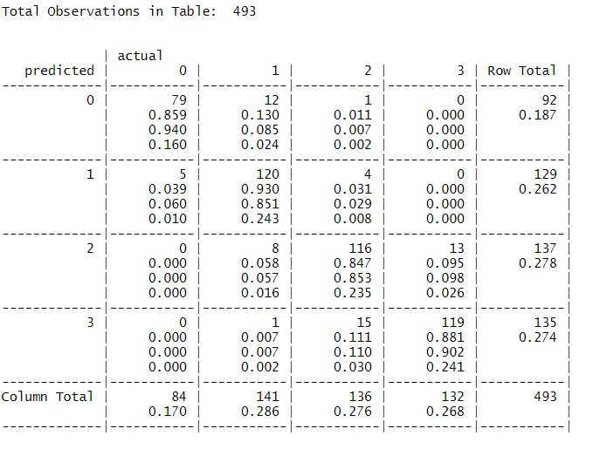
1st KNN Floor B0 Confusion Matrix
Kknn-5 can be optimized for floor Building 0 esp. floor 1, 2, 3
In Building 0
79 predictions for floor 0 were True Positives
120 predictions for floor 1 were True Positives
116 predictions for floor 2 were True Positives
119 predictions for floor 3 were True Positives
In 12 cases floor 1 was misidentified as 0 & 1 times floor 2 was misidentified as 0
In 5 cases floor 0 was misidentified as being floor 1 & in 4 cases floor 2 was misidentified as 1
In 8 cases floor 1 was misidentified as being floor 2 & in 13 cases floor 3 was misidentified as 2
In 1 case floor 1 was misidentified as being floor 3 & in 15 cases floor 2 was misidentified as 3

Slide 15
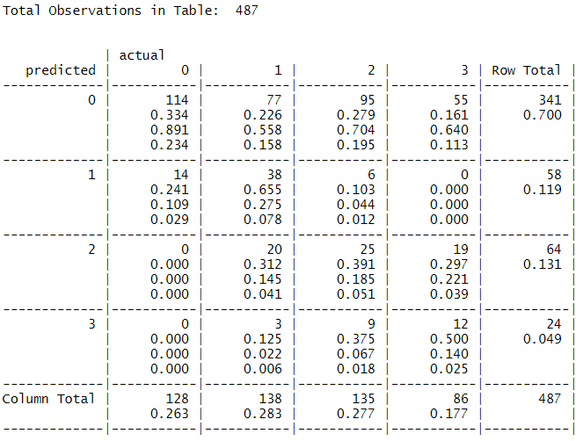
1st KNN Floor B1 Confusion Matrix
B1 predictions for floor has an accuracy of 38.8% & esp. floor 1,2,3 is not predicted well
In Building 1
114 predictions for floor 0 were True Positives
38 predictions for floor 1 were True Positives
25 predictions for floor 2 were True Positives
12 predictions for floor 3 were True Positives
In 77 cases floor 1 was misidentified as 0, 95 were identied as floor 2 and 55 as floor 3 instead of 0
In 14 cases floor 0 was misidentified as being floor 1 & in 6 cases floor 2 was misidentified as 1
In 20 cases floor 1 was misidentified as being floor 2 & in 19 cases floor 3 was misidentified as 2
In 3 case floor 1 was misidentified as being floor 3 & in 9 cases floor 2 was misidentified as floor 3

Slide 16
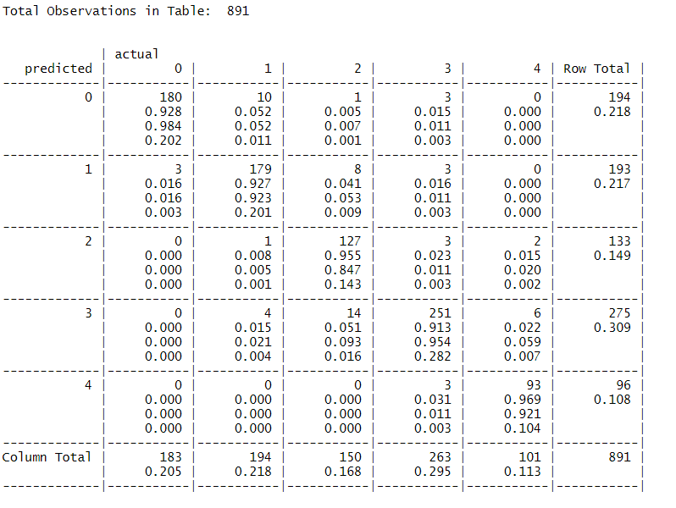
1st KNN Floor B2 Confusion Matrix
Kknn-5 was working fine for predictions in Building 2
In Building 2
180 predictions for floor 0 were True Positives
179 predictions for floor 1 were True Positives
127 predictions for floor 2 were True Positives
251 predictions for floor 3 were True Positives
93 predictions for floor 4 were True Positives
In 10 cases floor 1 was misidentified as 0, 1 was identified as floor 2 and 3 as floor 3 instead of 0
In 3 cases floor 0 was misidentified as being floor 1 & in 8 cases floor 2 was misidentified as 1
In 1 case floor 1 was misidentified as being floor 2 & in 3 cases floor 3 as 2 & 2 cases floor 4 as 2
In 4 cases floor 1 was misidentified as being floor 3 & in 6 cases floor 4 was misidentified as floor 3
In 3 cases floor 3 was misidentified as being floor 4 .

Slide 17
Conclusions of 1st KNN predictions
First focus is to improve the predictions for Building 1 and have a higher accuracy without downsizing the KPI’s for other Buildings.
Plan of attack:

